Slide 1
Reimagining Acquisitions with NITAAC: Fort Gordon Virtual Innovation Day
Ed Wilgus
March 4, 2021

Slide 2
NITAAC Overview
NIH Information Technology Acquisition & Assessment Center (NITAAC)
Housed within HHS/NIH
25+ years experience in government-wide IT contracting
Sole mission is to manage the NIH GWACs
Designated Federal Executive Agent administers three Best in Class Government-Wide Acquisition Contracts (GWACs) for any civilian or Department of Defense (DoD) agency needing Information Technology:
Services
Solutions
Commodities
Streamlines Acquisitions Process through FAR 16.505 and value-adds
Fulfilled over $5.8B of federal IT requirements FY19 and over $4B in FY20

Slide 3
Designated as BIC Vehicles
The Best in Class (BIC) acquisition designation identifies government-wide contracts that satisfy key criteria defined by the Office of Management and Budget (OMB).
Best in Class solutions are vetted, well-managed, recommended—and in some cases—required for use.
Interagency government-wide category teams have worked to designate over 30 Best in Class contracts to reduce the amount of effort individual buyers spend finding and researching acquisition solutions.

Slide 4
U.S. DEPARTMENT OF HEALTH AND HUMAN SERVICES
National Institutes of Health

Slide 5
CIO-SP3 and CIO-SP3 Small Business at a Glance
$20 Billion Ceiling
10 Year Ordering Period (2012 – 2022)
15 Year Performance Period (2012 – 2027)
Commercial & Non-Commercial IT Solutions

Slide 6
CIO-SP3 & CIO-SP3 Small Business Scope
CIO-SP3
51 Contract Holders
Large & Small Businesses
Eligible in All 10 Task Areas
NCAF 0.65% ($150K Annual Cap)
Orders Range From $50K-$700M
CIO-SP3 Small Business
339 Contract Holders
Small & Large Businesses
Not Eligible in All 10 Task Areas
NCAF 0.55! ($150K Annual Cap)
Orders Range from $15K-$400M
5 Socioeconomic Categories
8(a)
HubZone
SDVOSB
SB
WOSB
Everything IT!
Services and Solutions Across 10 Task Areas
IT Services for Biomedical Research Health Science & Healthcare
Chief Information Officer (CIO) Support
Imaging
Outsourcing
IT Operations and Maintenance
Integration Services
Critical Infrastructure Protection and Information Assurance
Digital Government
Enterprise Resource Planning
Software Development
U.S. DEPARTMENT OF HEALTH AND HUMAN SERVICES
National Institutes of Health

Slide 7
U.S. DEPARTMENT OF HEALTH AND HUMAN SERVICES
National Institutes of Health

Slide 8
CIO-CS at a Glance
$20 Billion Ceiling
5 Year Base & 5 Year Option (2015 – 2025)
15 Year Performance Period (2015 – 2030)
Commodity-Enabling Solutions

Slide 9
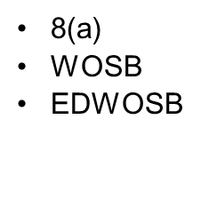
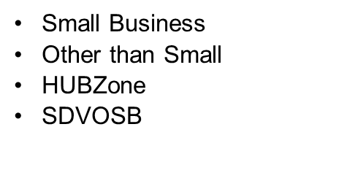
CIO-CS Scope
Everything IT!
Commodities and Commodity-Enabling Solutions
Two Deployment Models: On-Premise and Managed Services including Cloud
Hardware and Software
Cybersecurity
Enterprise-Wide Licenses, Maintenance and Warranties
Health and Biomedical Research IT
IaaS, PaaS, SaaS and other Cloud Solutions
Telecommunications Plans
Mobility Devices
Video-Conferencing
Engineering and Assessment Studies
Deployment and Installation
Web and Social Media
Collaboration Tools e.g. SharePoint
U.S. DEPARTMENT OF HEALTH AND HUMAN SERVICES
National Institutes of Health

Slide 10
NITAAC Customer Support Services
1 Hour Response time for all inquiries
Free Technical Assessments on SP3 & SP3 Small Business within 12 hours; call or email NITAACsupport@nih.gov
Free GWAC Training; monthly or on-site; feds only earn two continuous learning points (CLPs)
Library of Tools/Templates at nitaac.nih.gov
Live Representatives (8 am-6 pm) 1.888.773.6542

