Slide 1
The Lilt Platform
April 2021
lilt.com

Slide 2
| The Lilt Platform

Slide 3
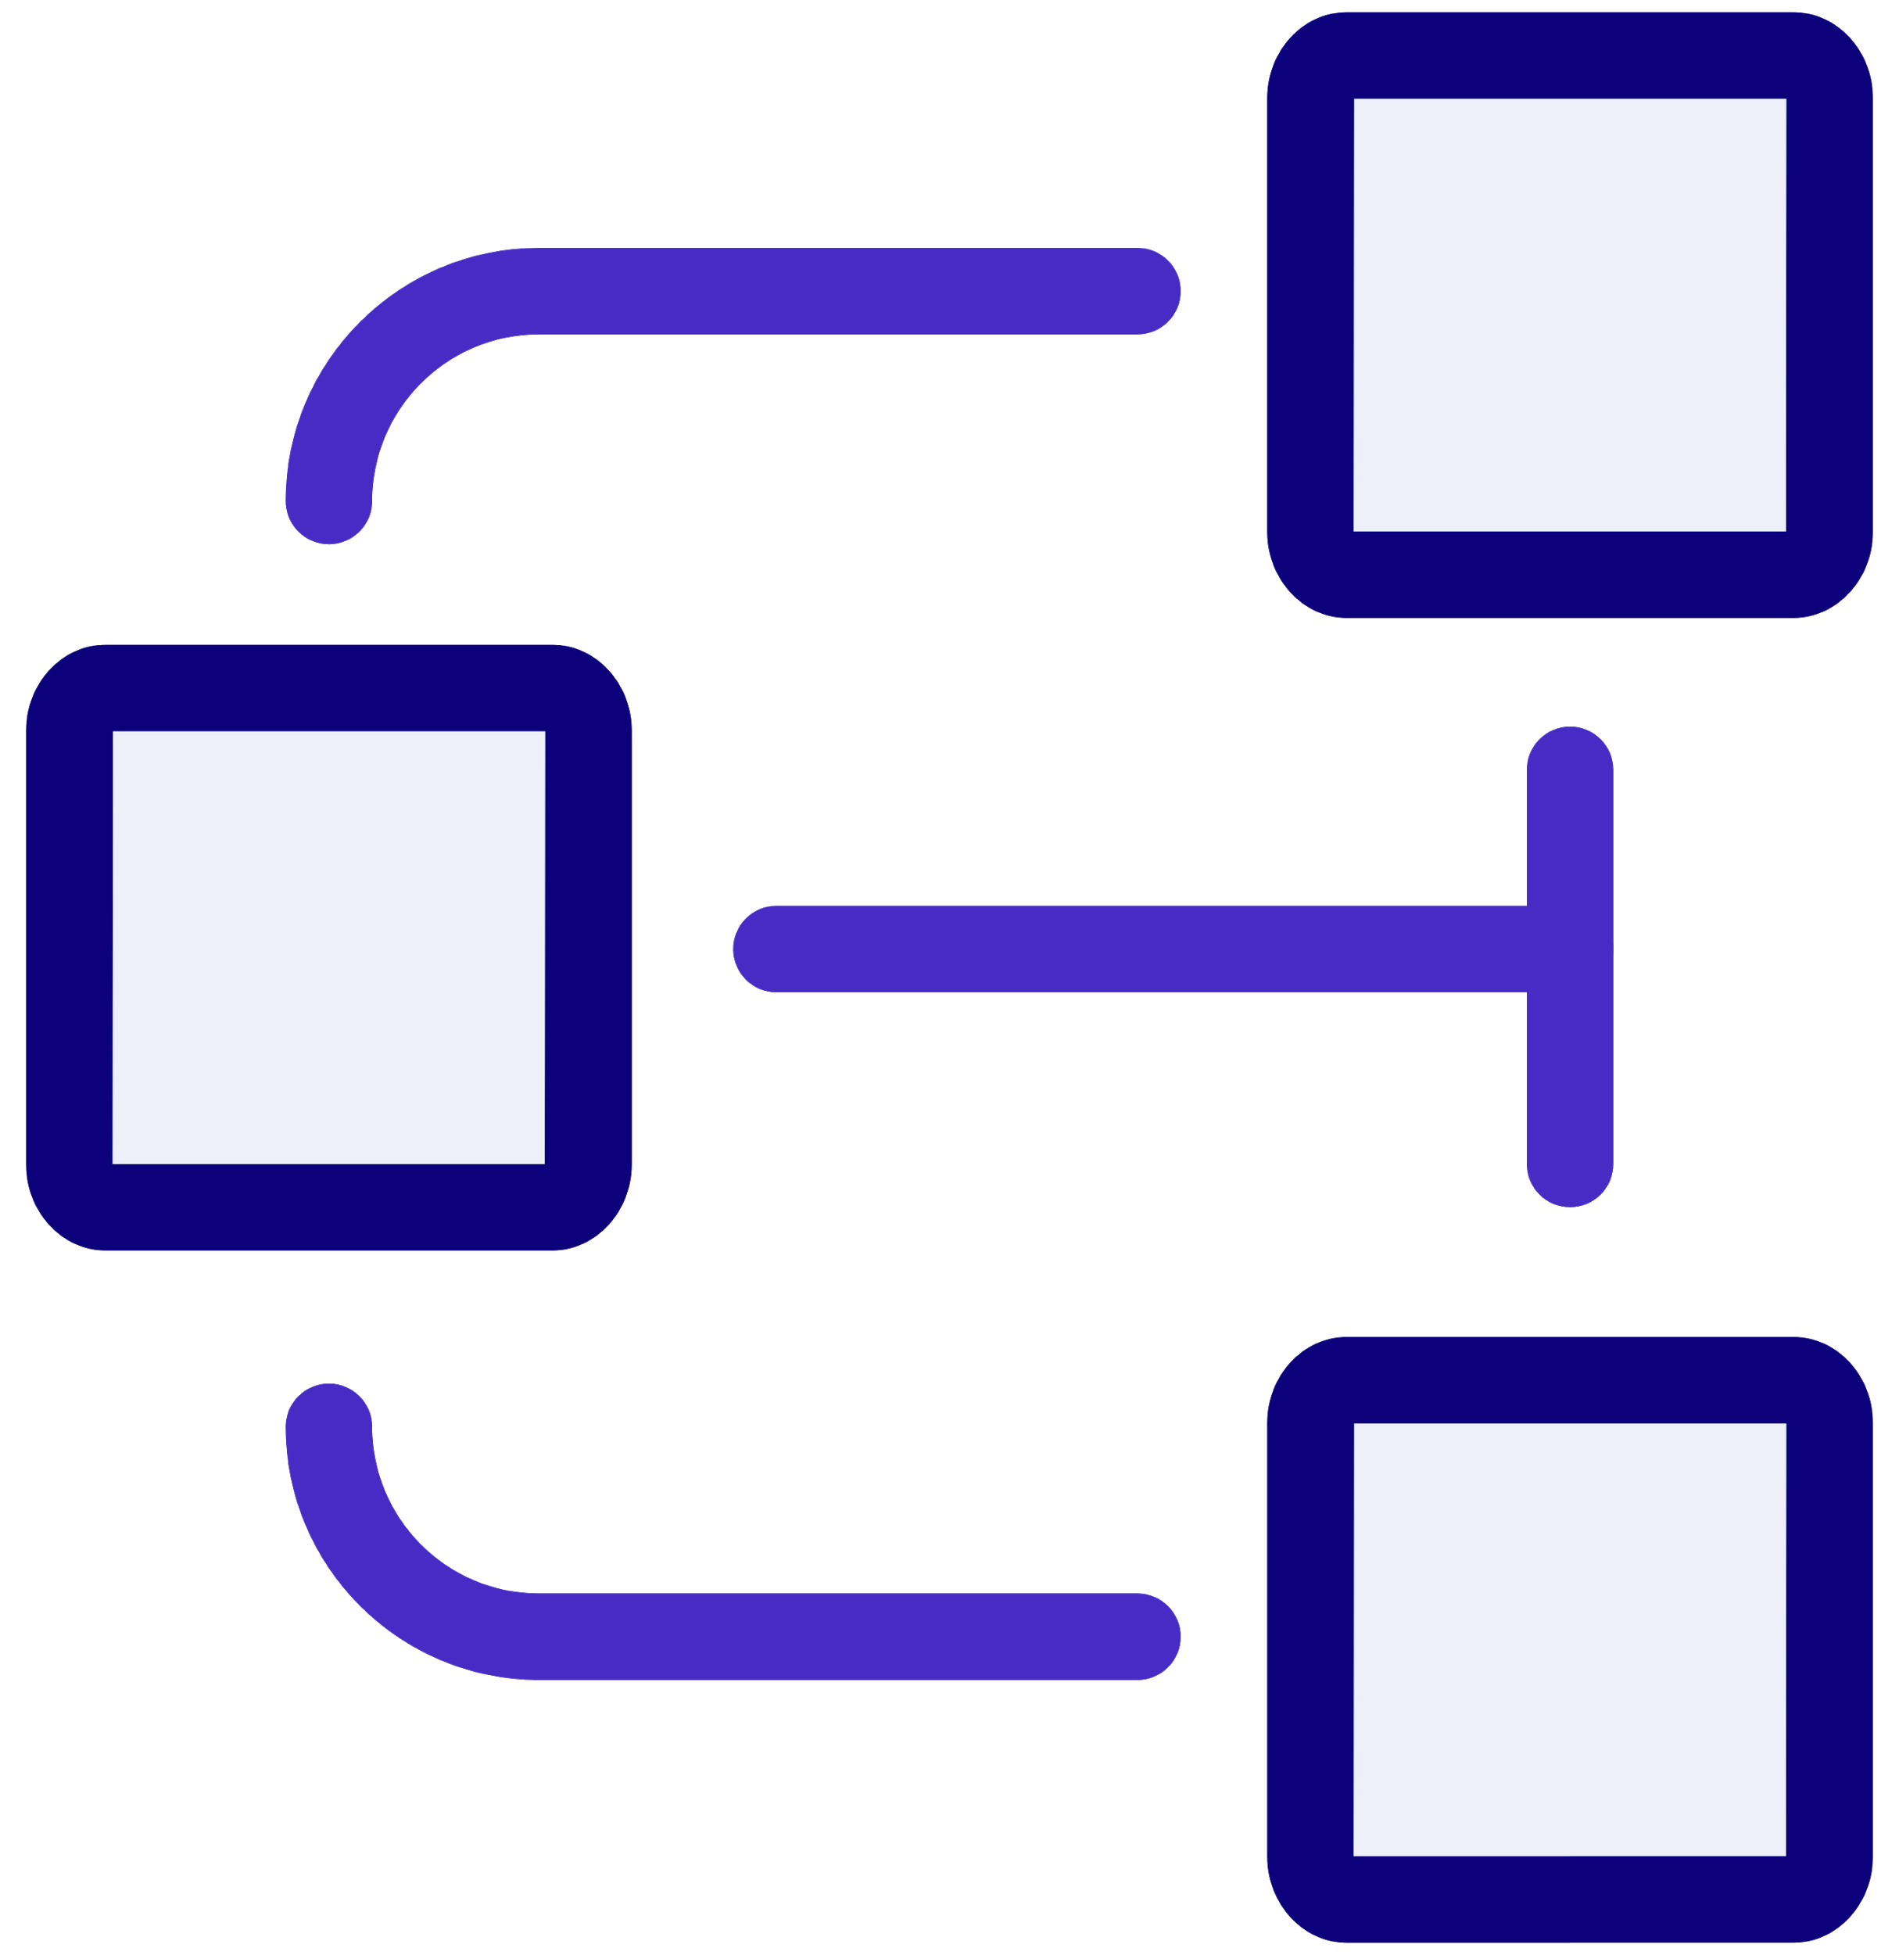
The Lilt Platform: Products
Products
Translate
Manage
Connect
Intelligence + Automation
Lilt Proprietary - Do Not Distribute
Notes:
Lilt is the modern language service and technology provider enabling localized customer experiences. We bring human-powered, technology-assisted translations to global enterprises.
Our translation services are powered by the Lilt Platform, which uses automation and AI to make every step of the localization process better and faster.
The Lilt Platform is made up of three products - Translate, Manage, and Connect. Each of these products is supported by various platform features.
Translate is where our translators and reviewers spend their time working to localize your content. Our Translate tool uses AI to support the translation, review, and QA processes that every piece of content goes through, enabling translators to produce the highest quality work, faster than ever.
Manage is where services managers and business users live, managing your translation projects from start to finish. Business users can review content, get information on their projects’ status, and even view analytics on localization performance.
Connect is how your content goes from your systems to the Lilt Platform - and back. Our marketplace of out-of-the-box Connectors enable you to easily sync many of the most popular content systems to the Lilt Platform with the click of a button. And if you use another type of system, our open API makes it easy to build a custom integration.

Slide 4
The Lilt Platform: Features
Intelligence & Automation
The Lilt Engine
Workflow
Lilt Insights
API
Translate Engine
AutoAssign
Review Engine
Loc Engineering
Lilt Proprietary - Do Not Distribute
Notes:
Lilt is the modern language service and technology provider enabling localized customer experiences. We bring human-powered, technology-assisted translations to global enterprises.
Our translation services are powered by the Lilt Platform, which uses automation and AI to make every step of the localization process better and faster.
The Lilt Platform is made up of three products - Translate, Manage, and Connect.
Translate is where our translators and reviewers spend their time working to localize your content. Our Translate tool uses AI to support the translation, review, and QA processes that every piece of content goes through, enabling translators to produce the highest quality work, faster than ever.
Manage is where services managers and business users live, managing your translation projects from start to finish. Business users can review content, get information on their projects’ status, and even view analytics on localization performance.
Connect is how your content goes from your systems to the Lilt Platform - and back. Our marketplace of out-of-the-box Connectors enable you to easily sync many of the most popular content systems to the Lilt Platform with the click of a button. And if you use another type of system, our open API makes it easy to build a custom integration.
A layer of intelligence and automation

Slide 5
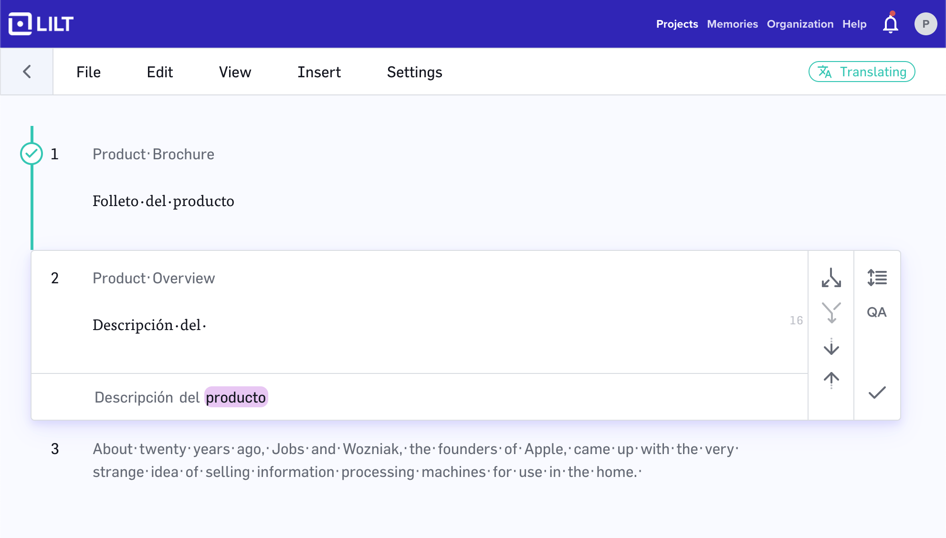
Translate faster than ever with Lilt Translate
Predictive, adaptive translation suggestions from TMs, Termbases, and customized MT
Higher ROI for your localization spend
10% higher TM leverage than competitors
Global coverage for your customers
Supports 300+ languages
Quicker go-to-market times
2-3x faster content translation
Optimized user experience for translators
Highly responsive and visually optimized
Predictive, adaptive translation suggestions
Supported by the Lilt Translate Engine and Lilt Review Engine
Notes:
Unlimited TM-supported languages, 50+ MT-supported languages
Powerful TM, MT, and termbase suggestions
2-3x faster translation vs. legacy CAT tools
Responsive: 100 ms average response time
Research-inspired ergonomics
Integrated with AutoTranslate and AutoReview
Why? Translators are at the center of any great localization program
Product
CAT v3 introduction
Lilt has a dedicated HCI research team that designs and improves this product, continuously iterating and optimizing for maximum user experience and productivity

Slide 6
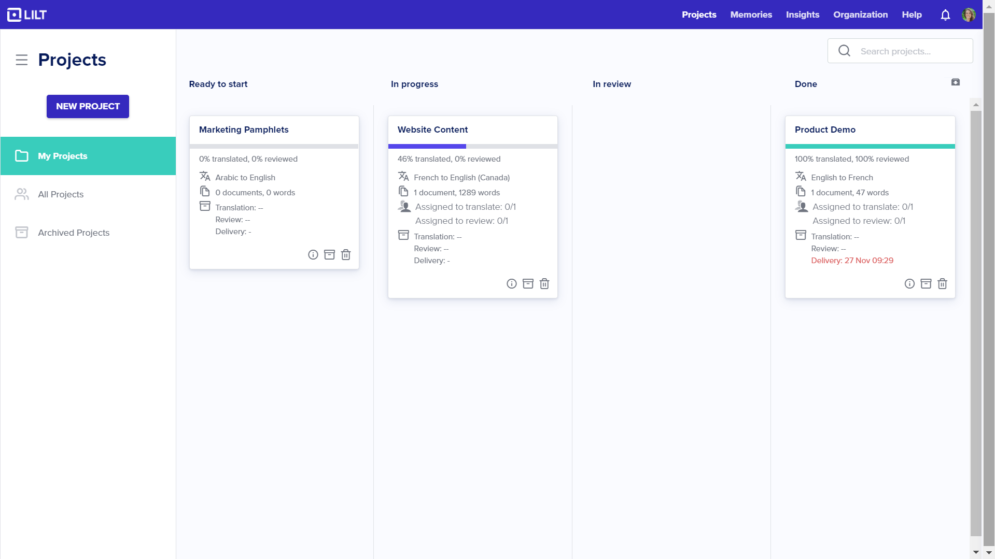
Streamline your program workflows with Lilt Manage
Easily plan, organize, and run localization projects and programs in Lilt Manage
Project oversight at your fingertips
Real-time project tracking
Customized workflows to meet your needs
Configurable workflow stages
Up-to-date linguistic assets
Real-time terminology validation workflow
An intuitive user experience
Streamlined project updating
Notes:
Manage is the Lilt Kanban Board, or more commonly referred to as the project management interface. Lilt service managers and software customers use Workflow to manage their translation projects, timelines, linguist assignment, and linguistic asset management. Worklow is also the interface that is currently used by customers for content review in Lilt.
10% higher leverage translation memory
Configurable workflow stages
Real-time project tracking via Insights
Real-time terminology harvesting and validation workflow
Seamless integration with AutoTranslate for human and automatic workflows

Slide 7
Lilt Jobs and Lilt Projects
INTERNAL: NOT CUSTOMER FACING
Project
A single file or files that needs to be translated from a source language to a single target language (a single language pair)
There can be multiple projects that all have the same source document; the key distinction is the target language
Job
A group of projects, all with some organizational affiliation or logic
A job can have a single file or multiple files; the key distinction is the inclusion of multiple target language pairs
Example (on right): A job could have one source document, with a number of different target languages.
Job: Website Homepage
Project: Website homepage, EN > FR
Project: Website homepage, EN > DE
Project: Website homepage, EN > RU
Project: Website homepage, EN > CR
Project: Website homepage, EN > ES
Project: Website homepage, EN > AR
Notes:
QA Umbrella with different tools:
Quality: linguist quality, tools used by linguist, tools not used by linguist.
Quality Assurance Toolkit:
TM QA
Batch QA
AutoReview

Slide 8
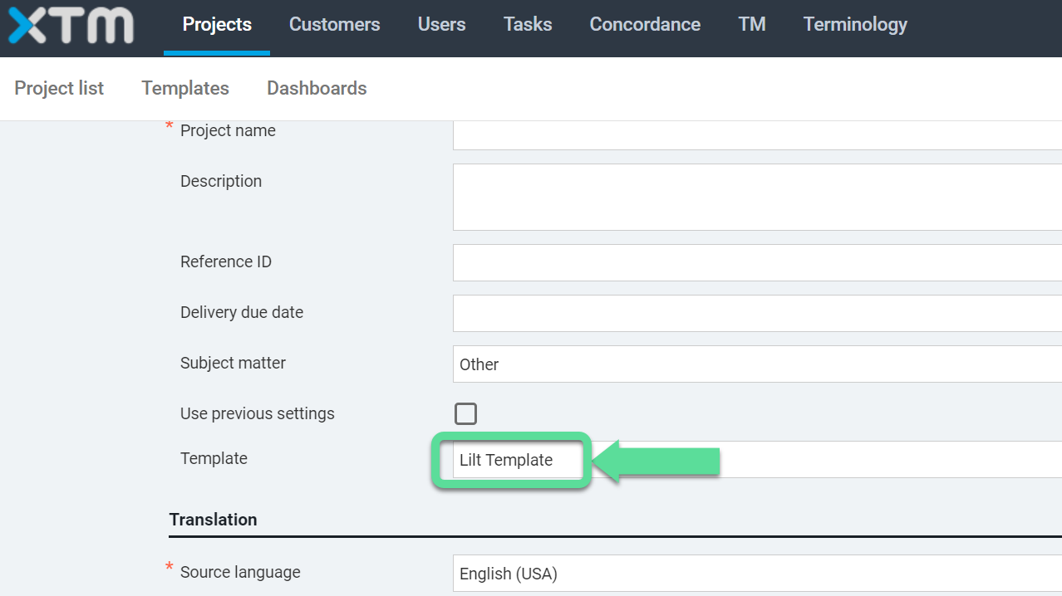
Turnkey content exchange via TMS with Lilt Connect
One-click content and linguistic asset exchange to and from Lilt across industry-leading TMSs
Streamline your program with TMS integrations Works across SDL TMS, SDL WorldServer, XTM Cloud, Smartling, WebTranslateIt, and others Project oversight in your TMS of choice Receive status updates, view project progress reporting, and more - all from within your TMS interface
Notes:
Connect offers two forms of connectivity to Lilt: connection via TMS (translation management systems), and connection via CMS (content management systems). Lilt’s turnkey TMS Connectors
Why: turn-key enterprise solution, make digital transformation easier than ever

Slide 9
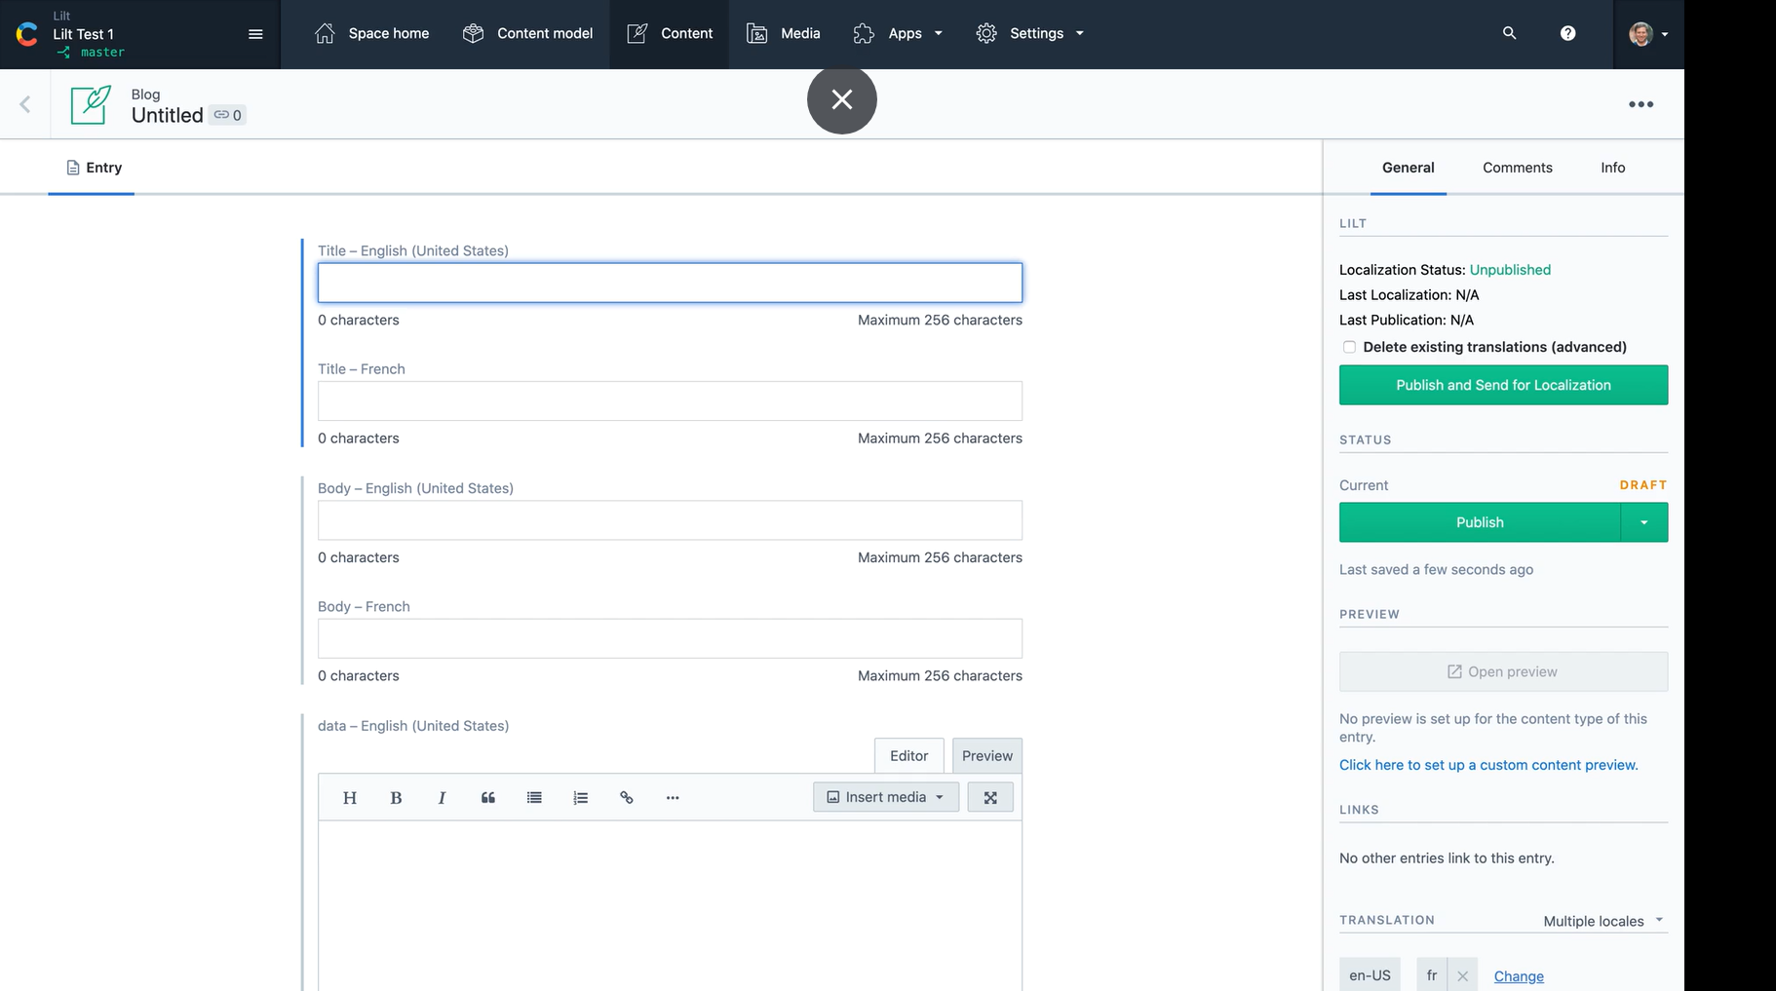
Turnkey content exchange via CMS with Lilt Connect
One-click content and linguistic asset exchange to and from Lilt across a variety of content systems
Localize content directly within your CMS
Adobe Experience Manager, Contentful, Drupal, WordPress, easyDITA, Episerver
Send and receive content through cloud storage
AWS, Box, Dropbox, Google Drive, Microsoft Onedrive
Localized support content directly in your systems
Salesforce, Zendesk, Slack
Localized code dropped right into your code repo
Git, GitHub, GitLab, Bitbucket
Notes:
Our philosophy: Do localization where content ops happens
Why: turn-key enterprise solution, make digital transformation easier than ever

Slide 10
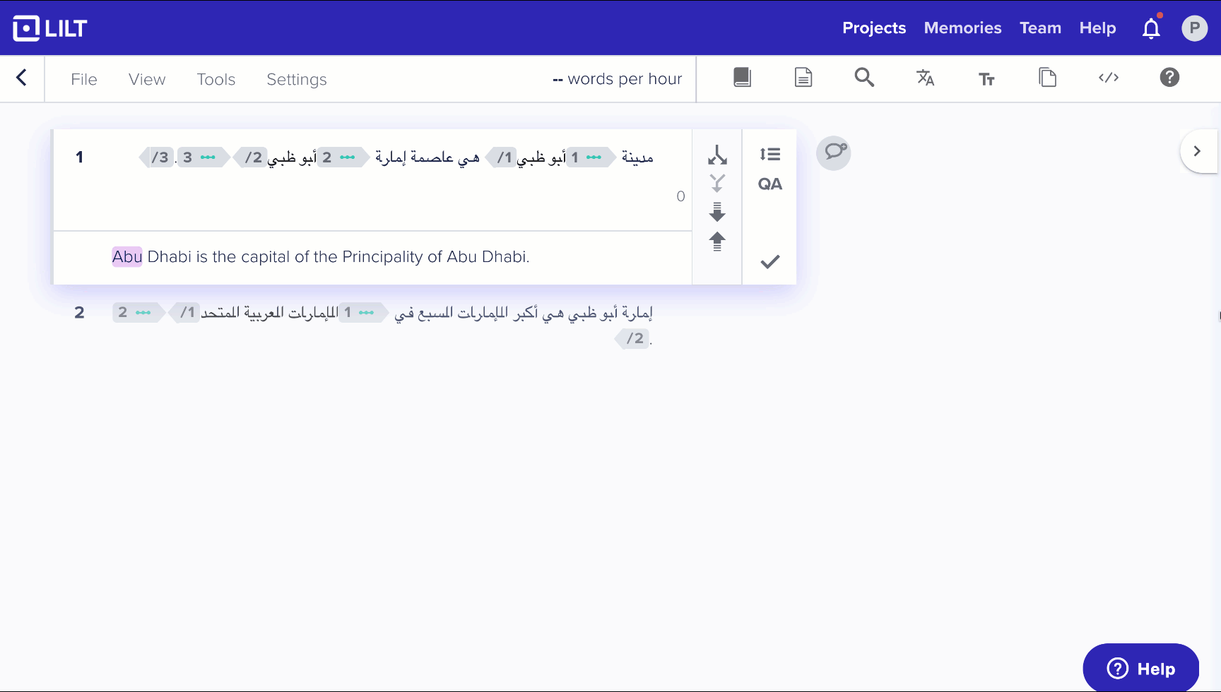
Continuously improve with the Lilt Translate Engine
Predictive, adaptive neural machine translation suggestions
Real-time, customized translation suggestions
Custom engine development with neural self-training
Powerful MT suggestions
Integrated to support Lilt Translate
MT assistance where you need it
50+ languages and native support for locales
and dialects
Notes:
AutoTranslate is the neural machine translation engine that powers Lilt.
When beginning to work with you (new customer), Lilt builds a specialized, unique-to-you base NMT model using publicly available data. Linguists translate using the NMT suggestions from that model, suggestions from
As linguists translate, their feedback is incorporated into the model
A Lilt TM is built by combining your historical TMs, and content that you have translated with Lilt. It is a living TXM file that is constantly being updated in real time as Lilt linguists translate new content for you, and that feedback is incorporated into your larger TXM file.
Why? Translators are at the center of any great localization program
Product
CAT v3 introduction
Automatic custom engine development with neural self-training
Integrated with translation memory
Live termbase ensures terminological consistency
50+ languages, and native support for locales and dialects

Slide 11
Translation Memories and Lilt Memory
INTERNAL: NOT CUSTOMER FACING
A Lilt Memory uses traditional Translation Memories as part of its process to decide the best translation
Translation Memory
Lilt Memory
A “Translation Memory” is a historical compilation of a set of translations that have been previously localized and approved by a given company
They are updated periodically as additional documents are localized and added to the set
Lilt builds a traditional “Translation Memory” for each customer in Lilt as Lilt linguists translate additional customer documents
A “Translation Memory” can be imported into and exported from Lilt
A “Lilt Memory” is the combination of sources that are referenced by the Lilt Platform to decide what translation suggestion to provide to a linguist
A “Lilt Memory” references a company’s “Translation Memory”, a company’s termbase, and the Lilt Translate Engine to find the best translation suggestion
A “Lilt Memory” follows this reference sequence in determining the best suggestion:
>75% match = “Translation Memory”
<75% Match = Lilt Translate Engine
Termbase
A “Lilt Memory” cannot be exported from Lilt”
See more “Memories” vernacular here
Notes:
Lilt Memory > The Lilt Engine + Translation Memory + TB; dynamic thing that feeds the CAT tool. We export traditional translation memories - any translations that have been done by that account. and or term bases - whatever they’ve built within the Lilt memory.

Slide 12
The Lilt Platform: Features
Intelligence & Automation
The Lilt Engine
Workflow
Lilt Insights
API
Translate Engine
AutoAssign
Review Engine
Loc Engineering
Lilt Proprietary - Do Not Distribute
Notes:
Lilt is the modern language service and technology provider enabling localized customer experiences. We bring human-powered, technology-assisted translations to global enterprises.
Our translation services are powered by the Lilt Platform, which uses automation and AI to make every step of the localization process better and faster.
The Lilt Platform is made up of three products - Translate, Manage, and Connect.
Translate is where our translators and reviewers spend their time working to localize your content. Our Translate tool uses AI to support the translation, review, and QA processes that every piece of content goes through, enabling translators to produce the highest quality work, faster than ever.
Manage is where services managers and business users live, managing your translation projects from start to finish. Business users can review content, get information on their projects’ status, and even view analytics on localization performance.
Connect is how your content goes from your systems to the Lilt Platform - and back. Our marketplace of out-of-the-box Connectors enable you to easily sync many of the most popular content systems to the Lilt Platform with the click of a button. And if you use another type of system, our open API makes it easy to build a custom integration.
A layer of intelligence and automation

Slide 13
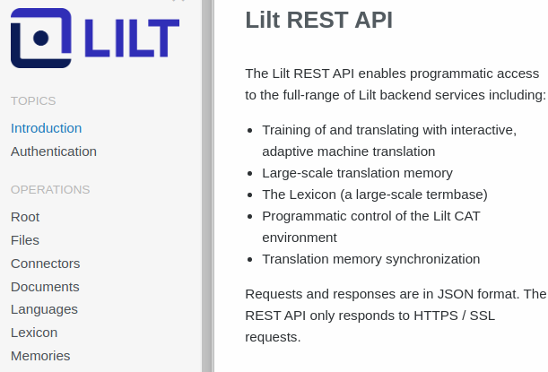
Endpoints for data, MT, and visualization with Lilt API
API-first design with pre-built client libraries for workflow integration
A feature of Lilt Connect, Lilt API enables:
Automated, continuous content exchange
Access to extensive client libraries
Faster MT processing speeds
186,000 words / min batch processing
Streamlined access to:
Batch machine translation
Custom MT training
Source document management
Data visualization
Notes:
Why? You need to manage your program and measure ROI
Products
Lilt Insights V2
Website Translation Analytics (Project Arden). You have a limited translation budget, and you want to get the maximum bang for your buck. Lilt’s Website Translation Analytics integrates with your existing Google Analytics account, to measure how translations you deploy on your website are impacting traffic and conversions. It also monitors traffic patterns to suggest to you what pages you should translate to which languages to maximize your translation ROI.
Client libraries for popular languages such as Java, Javascript, and Python
186k words / min batch processing on Lilt’s standard compute unit
Supports use cases including
Batch machine translation
Custom MT training
Source document management
Data visualization

Slide 14
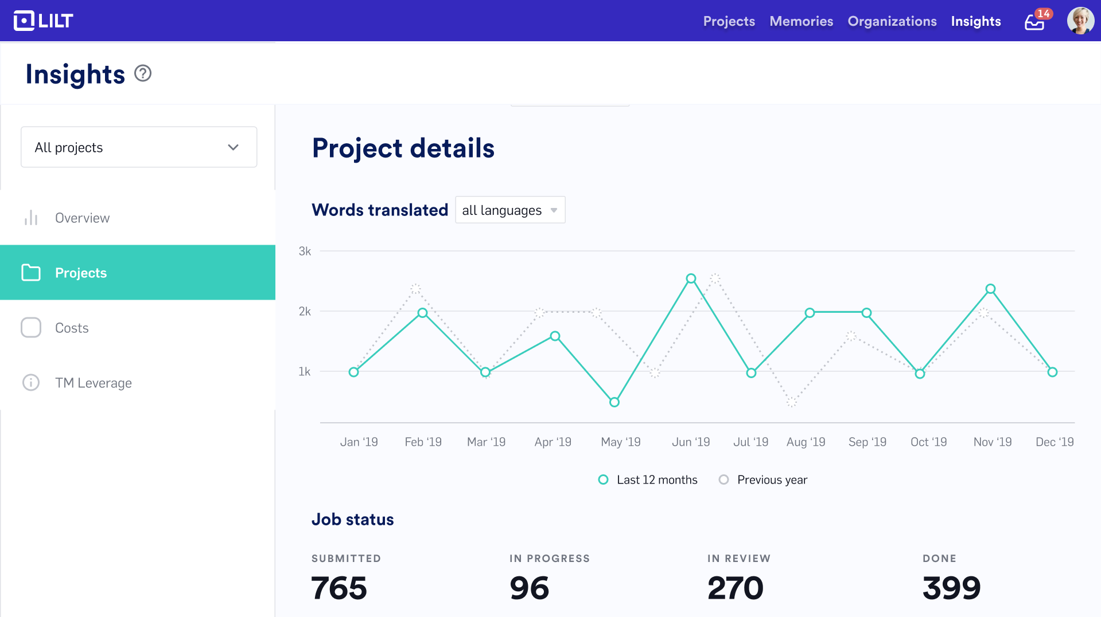
Make data-driven decisions with Lilt Insights
Increased visibility into localization program performance, ROI, and impact with reporting and analytics
Drive program decisions with data
Customizable performance data and reporting
Control and oversee program spend
Easily track and manage spend
Measure and report on localization impact
Track your localization ROI with Google Analytics
Connect directly to your BI tool
Tableau, Power BI, Qlik, and many more
Notes:
Why? You need to manage your program and measure ROI
Products
Lilt Insights V2
Website Translation Analytics (Project Arden). You have a limited translation budget, and you want to get the maximum bang for your buck. Lilt’s Website Translation Analytics integrates with your existing Google Analytics account, to measure how translations you deploy on your website are impacting traffic and conversions. It also monitors traffic patterns to suggest to you what pages you should translate to which languages to maximize your translation ROI.
Customizable data and reporting
Direct access to monitoring and oversight of progress and performance for past, current, and future projects
Includes translation status, due dates, word counts per page, XML files, and more
Measure localization ROI in Google Analytics
Ability to track and manage localization spend
Connectly directly to popular BI tools including Tableau, PowerBi, Qlik, and others

Slide 15
The Lilt Platform: Product and Feature Descriptions
INTERNAL: NOT CUSTOMER FACING
Name | Category | Description | Functionality
Lilt Translate | Product | Predictive, adaptive translation tool for translators and reviewers | Computer-aided translation (CAT)
Lilt Manage | Product | Production workflow tool for services managers and loc. engineers | Services TMS (e.g., Memsource)
Lilt Connect | Product | CMS connectors, TMS connectors, file processing | Connectors, file filters
Lilt Insights | Feature | Basic reports, advanced reports (via API), content analytics | Analytics
Lilt API | Feature | Developer API with client libraries for many programming languages | API
Lilt Translate Engine | Feature | Self-learning neural translation system with integrated TM and termbase | Machine translation, TM, termbase
On the Lilt roadmap
Lilt Manage | Product | Enterprise management interface | Enterprise TMS (e.g. Worldserver)
Lilt Review Engine | Feature | AI-powered quality assurance workflow and tools | QA scripts (e.g., XBench)

Slide 16
The Lilt Platform: User Roles
INTERNAL: NOT CUSTOMER FACING
Name | Category | Users | Functionality
Lilt Translate | Product | Translator, Reviewer | Computer-aided translation (CAT)
Lilt Manage | Product | Lilt Services Manager, Enterprise Manager, Govt. Manager | Services TMS (e.g., Memsource)
Lilt Connect | Product | Lilt Services Manager, Enterprise Manager, Govt. Manager, Software Engineer | Connectors, file filters
Lilt Insights | Feature | Lilt Services Manager, Enterprise Manager, Govt. Manager | Analytics
Lilt API | Feature | Software Engineer | API
Lilt Translate Engine | Feature | Translator, Reviewer, Lilt Services Manager, Enterprise Manager, Govt. Manager | Machine translation, TM, termbase
On the Lilt roadmap
Lilt Manage | Product | Enterprise Manager, Govt. Manager, Software Engineer | Enterprise TMS (e.g. Worldserver)
Lilt Review Engine | Feature | Translator, Reviewer | QA scripts (e.g., XBench)

Slide 17
| Appendix

Slide 18
Government-Grade Security On-Premise
Turn-key deployment in private clouds
Amazon Web Services
Amazon GovCloud
Microsoft Azure
Google Cloud
Deployable on bare metal
Unmanaged infrastructure
No external network connectivity required

Slide 19
Market Landscape: Lilt Platform Comparison
Deployable Anywhere | ✔ | ✔ | ✔ | ✔
In-House Research Team | ✔ | 🗴 | ✔ | 🗴
Custom Translation Models (Human/NMT) | ✔ | ✔ | 🗴 | 🗴
Interactive Neural Machine Translation | ✔ | 🗴 | 🗴 | 🗴
Adaptive Neural Machine Translation | ✔ | 🗴 | 🗴 | 🗴
Performance Metrics and Configurable Reporting | ✔ | 🗴 | 🗴 | 🗴
Real Time, Continuous Training | ✔ | 🗴 | 🗴 | 🗴
Complimentary:
Computer-Aided Translation (CAT) | ✔ | 🗴 | 🗴 | 🗴
Translation Management System (TMS) | ✔ | 🗴 | 🗴 | 🗴
Installation, Maintenance, Retraining | ✔ | 🗴 | 🗴 | 🗴
Translator Productivity (Words per Hour) | 700 - 1,200 | 250 - 400 | N/A | N/A

Slide 20
Market Landscape: Lilt Platform Comparison
Reach | 50 languages | 120 languages | Unlimited languages
Pricing | Complex pricing structure per language pair and license | Complex pricing structure per language pair and license | Simple per license fee
HQ Location | France | UK | US
NMT Translation Workflow | Post-editing | Post-editing | Human-in-the-loop and adaptive
Performance Reporting | None | None | Lilt Insights
Language Model Training | Requires regular updates and maintenance | Requires regular updates and maintenance | Adaptive and learns through use
Integrated apps (CAT, TMS) | Not included | Not included | Included
Customer Support | Fair | Must pay for varying levels of support | Strong and expedient with a max SLA of 24 hrs
Custom Programming | No customization | No customization | Offers custom engineering and feature development

Slide 21
Market Landscape: Lilt Enterprise MT Service
Reach | 50 languages | 55 languages | 60 languages | Unlimited languages
Pricing | Per character | Per character | Per character | Single fixed fee
Customizable Termbases | ✔ | ✔ | ✔ | ✔
Batch Upload and API Integration | ✔ | ✔ | ✔ | ✔
Supports Custom Models | ✔ | 🗴 | 🗴 | ✔
Dedicated HLT GOV Team | 🗴 | ✔ | 🗴 | ✔
Adaptive Training | 🗴 | 🗴 | 🗴 | ✔
Integrated apps (CAT, TMS, termbase, analytics, etc.) | 🗴 | 🗴 | 🗴 | ✔
Custom Eng Development | 🗴 | 🗴 | 🗴 | Custom engineering and feature development

Slide 22
Lilt Proprietary - Do Not Distribute

